Slide 1
DETECTION OF CYBER ATTACKS IN NETWORK USING MACHINE LEARNING TECHNIQUES
Presented by:
Kalyani Anna (217Z1A0588)

Slide 2

ABSTRACT
In todays world , the use of IOT device has been increased . By the increase of technology, most of the people are integrated to it.
Traditional security measures are insufficient to secure the data often lack the scalability with rapidly evolving attack techniques.
As a result there is a high demand for automated and proactive cyber defence mechanism capable of real time detection and classification of cyber attacks.

Slide 3
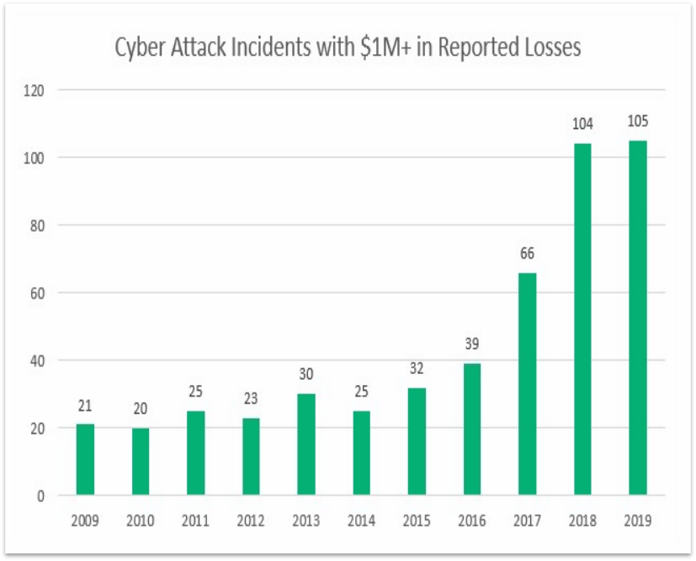
INTRODUCTION
It is a bar graph of cyber attacks that occurred from 2009-2019.CSIS conducted survey on cyber attacks that causes every year.
The CSIS tracks cyber attacks on government agencies, defense and high tech companies, economic crimes with losses of more than a million dollars.

Slide 4
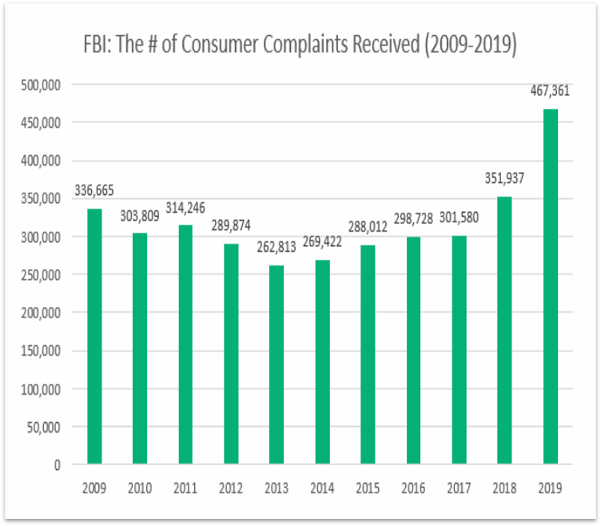
Continued..
Consumer complaints increased as compared to year by year which results in increase of cyber threats.
In order to prevent such threats we need to build good security to data and we use machine learning algorithms to detect cyber threats.

Slide 5
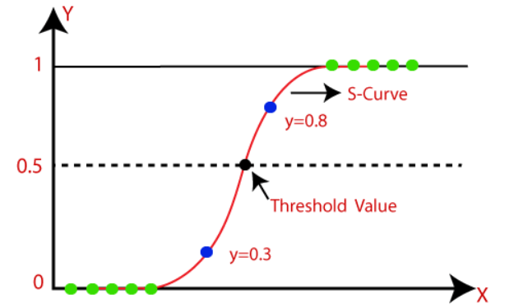
EXISTING METHODOLOGY
Logistic regression:
It is used for solving classification problems
It predicts the output of dependent variable.so, output must be either yes or no.
It is a statistical algorithm analyze the relationship between the dependent and independent variables.
Value of logistic regression must be 0 and 1.so it forms sigmoid function.

Slide 6
DISADVANTAGES
Assumption of linearity
Overfitting
Difficulty in handling the missing data

Slide 7
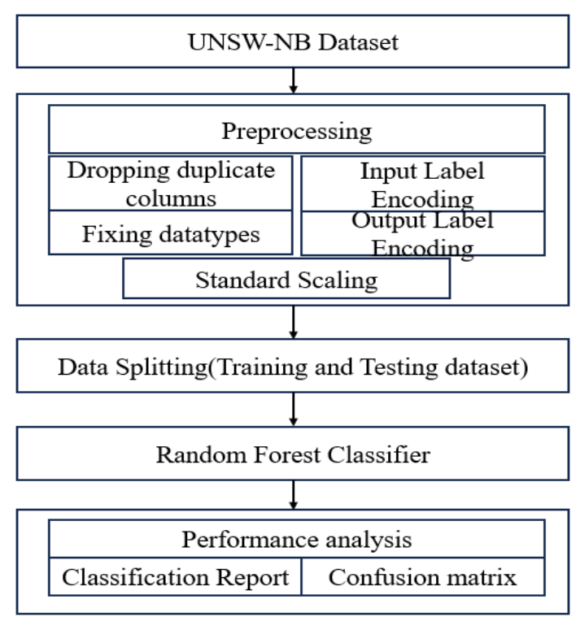
PROPOSED SYSTEM

Slide 8
Continued…
Step1: In this project we used UNSW-NB Dataset.
Step 2:Check whether the dataset contains Null values or not and we need to perform data preprocessing to convert the data into float from strings.
Step 3:Split the data x as input and y as output to perform training and testing.
Step 4:After performing training and testing ,we need to test the data with classifiers.
Step 5:Estimate the performance of different classifiers based on accuracy , precision and recall.

Slide 9
PROPOSED METHODOLOGY
Random forest algorithm
Step 1: In Random Forest n number of random records are taken from the data set having k number of records.
Step 2:Individual decision trees are constructed for each sample.
Step 3:Each decision tree will generate an output.
Step 4:Final output is considered based on majority voting or averaging for classification and regression respectively.

Slide 10
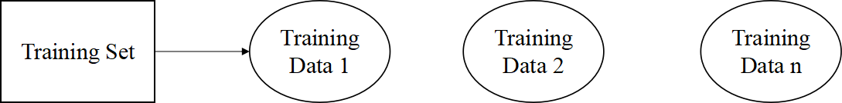
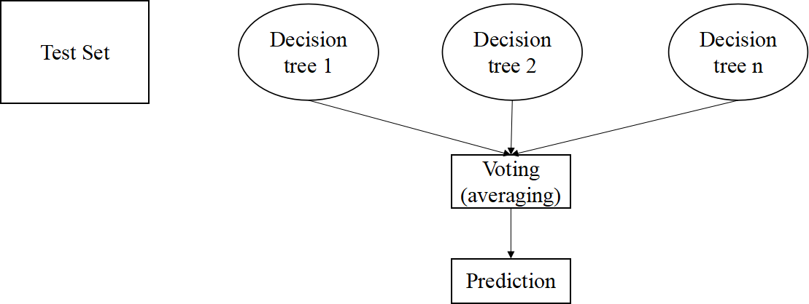
Continued….
….
….

Slide 11
ADVANTAGES
High accuracy
Reduced overfitting
Easy to use

Slide 12
CONCLUSION
Cyber attacks generate a huge loss to the organisations. In order to detect the attacks we found a solution called advanced machine learning algorithms.
Using random forest algorithm on a dataset and performed operations like data splitting, data preprocessing, testing and training, finding the maximum accuracy to detect the attacks.
The accuracy of the random forest is 85%.

Slide 13

ANY QUERIES

Slide 14
Thank you!

